Slide 1
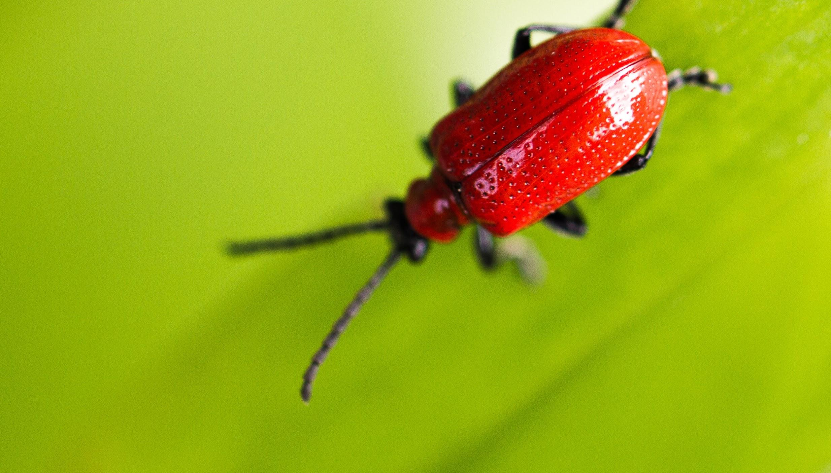
WHY WE CLASSIFY ANIMALS
We will explain why we classify organisms.
Notes:
Insert cover image and use transparency settings to fade image.

Slide 2

Fill in the following acronym
M ______________________
R ______________________
S ______________________
G ______________________
R ______________________
E ______________________
N ______________________
C ______________________

Slide 3
Fill in the missing type of variable below
Type of Variable | Definition
____________Variable | Only one variable that is changed on purpose in the experiment.
____________Variable | What is measured and what changes because of the independent variable.
____________Variable | All variables that are kept the same in an experiment.

Slide 4
Repeat the opposite word/phrase.
INDEPENDENT VARIABLE
WHAT IS CHANGED IN THE EXPERIMENT

Slide 5
Repeat the opposite word/phrase.
DEPENDENT VARIABLE
WHAT IS MEASURED AND CHANGES

Slide 6
Repeat the opposite word/phrase.
CONTROLLED VARIABLE
WHAT ARE KEPT THE SAME

Slide 7
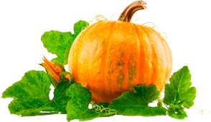
In this experiment, students wanted to see if pumpkin plants grow quicker in full sun not shade.
At the end of 4 weeks the pumpkin plants were measured in cm using a ruler.
Answer the following questions:
What the independent variable is?
What the dependent variable is?
What would be two controlled variables?

Slide 8
We will explain why we classify organisms.
TRACK WITH ME
READ WITH ME
We will define classification.
We will explain why classification systems are helpful.
We will list observable features used to classify animals.
DECLARE THE OBJECTIVE
Read the learning objective to your partner.
Notes:
Learning Objectives contain concepts (nouns, big ideas), skills (verbs, measurable behaviours) and sometimes context (restricting or targeting conditions).
●Example: Students will be able to describe the concept of density and apply it to floating and sinking.
●
Success criteria are specific measurable outcomes that if met mean that the student has met the learning objective.
Examples:
•Students will be able to compare densities of substances using mass and volume.
•Students will be able to identify whether a solid or liquid will float or sink in a liquid based on their densities.

Slide 9
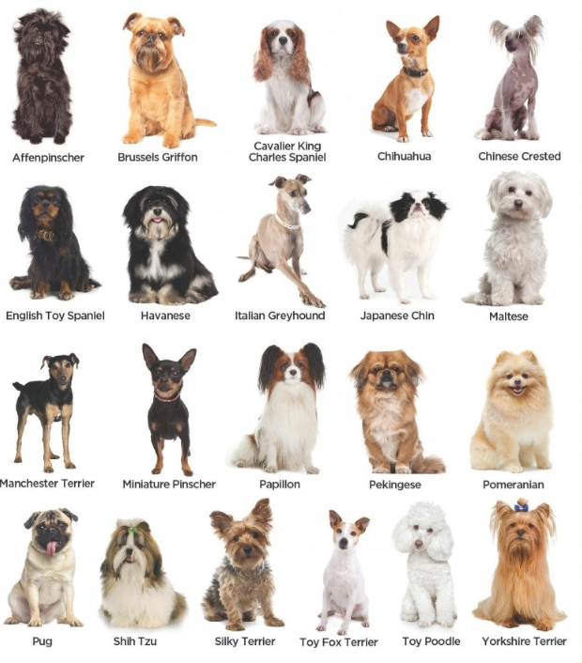
We will explain why we classify organisms.
There are hundreds of types of dogs. Each one looks different from one another but all dogs have some features in common.
Looking at this picture
How are these dogs different?
How are these dog similar?
MAKE THE CONNECTION
Students, you already know…. Dogs have fur, four legs and ears. They have different sized bodies and coat colour.

Slide 10
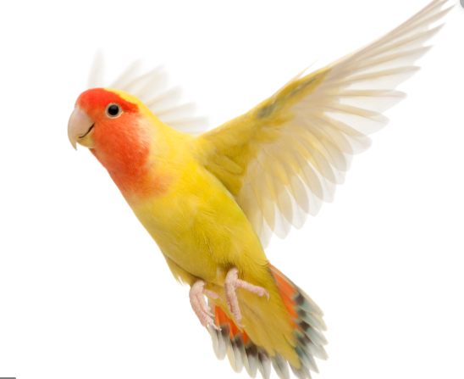
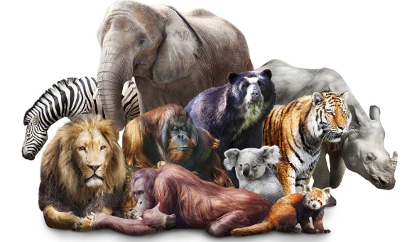
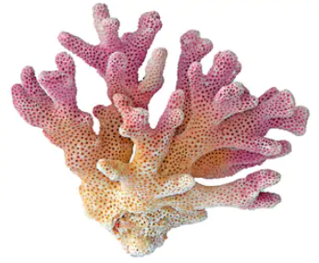
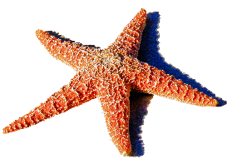
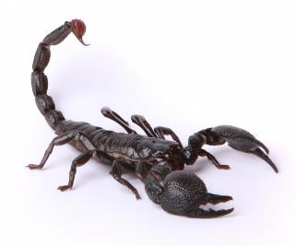
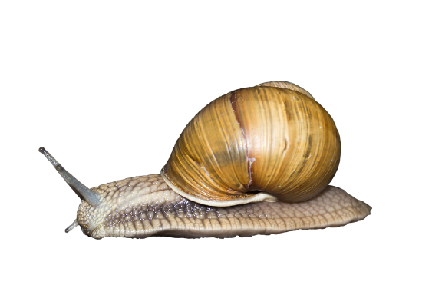
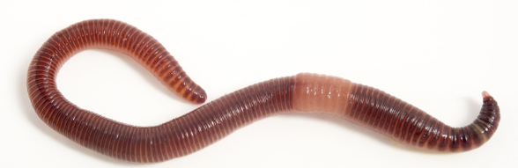
We will explain why we classify organisms.
Classification is a system of sorting organisms₁ such as plants and animals into different groups based on observable₂ features.
There are billions of different types of plants and animals that need to be classified into specific groups.
Classification helps identify newly discovered plants and animals that look similar to other animals.
CHECK FOR UNDERSTANDING
What observable feature helps you classify this animal as a bird?
VOCABULARY
1 - Living things 2 - What they look like

Slide 11
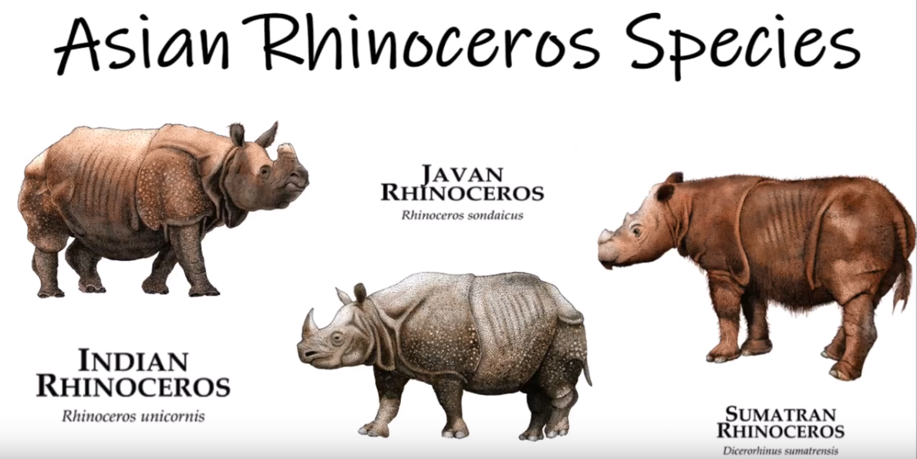
We will explain why we classify organisms.
Taxonomists are scientists who classify₁ plants and animals.
Scientist speak different languages so they need a worldwide classification system to help classify similar animals.
CHECK FOR UNDERSTANDING
Why is it important to have a classification system that is used worldwide?
English | rhinoceros
French | rhinocéros
Italian | rinoceronte
VOCABULARY
1 - group

Slide 12
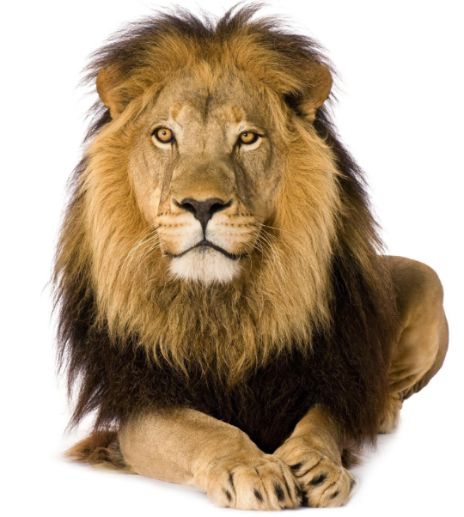
We will explain why we classify organisms.
Animals can be classified in lots of different ways but scientists will use observable₁ features.
Observable features used to classify animals include:
Body cover: fur, scales, feathers, skin.
Amount of legs: 2, 4, 6, 8.
Body feature: shell, tentacles, claws, tail.
CHECK FOR UNDERSTANDING
What is an observable feature of this lion?
VOCABULARY
1- what they look like

Slide 13
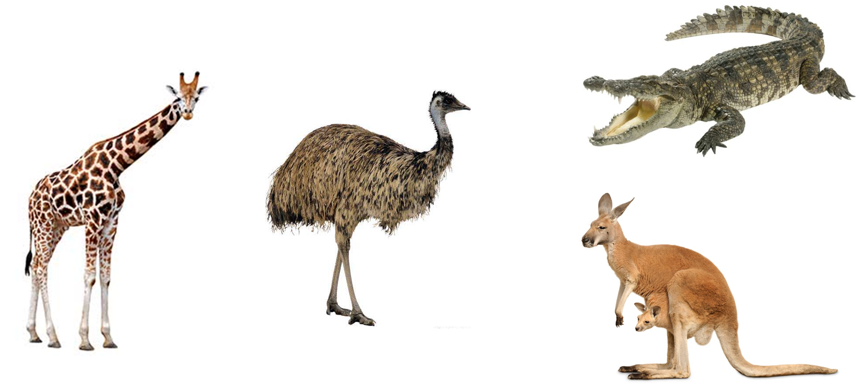
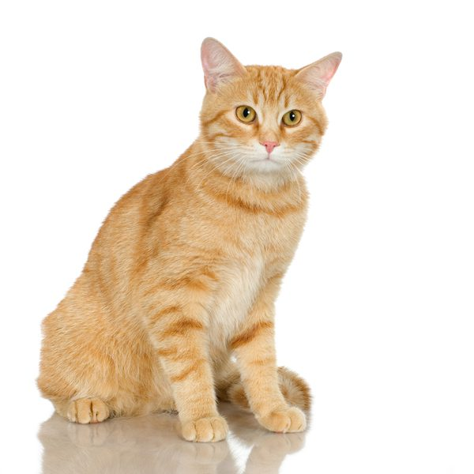
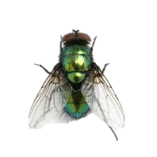
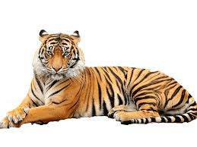
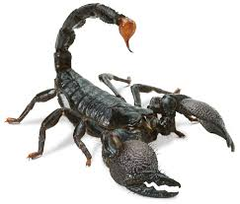
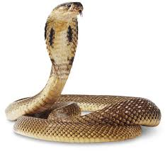
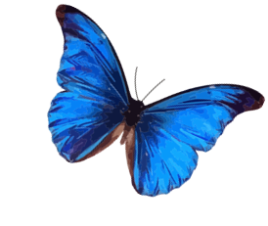
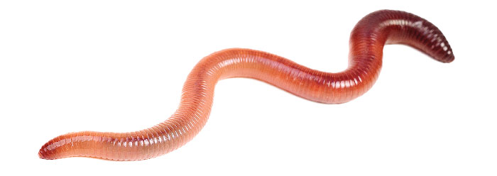
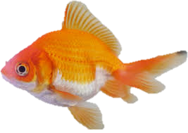
We will explain why we classify organisms.
CHECK FOR UNDERSTANDING
Why is it important to have a system to classify animals?
Classify the following animals with your own observable features.
Did people in the class have similar or different ways to classify these animals?
HINT
Students, remember…. Classification is a system of sorting organisms such as plants and animals into different groups based on observable features.
Crocodile
Cat
Fly
Emu
Kangaroo
Giraffe
Scorpion
Goldfish
Tiger
Cobra
Earthworm
Butterfly

Slide 14
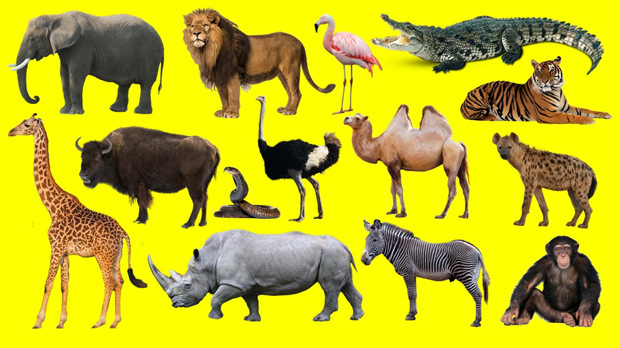
We will explain why we classify organisms.
CHECK FOR UNDERSTANDING
Why is it important to have a system to classify animals?
Classify the following animals with your own observable features.
Did people in the class have similar or different ways to classify these animals?
HINT
Students, remember…. Classification is a system of sorting organisms such as plants and animals into different groups based on observable features. Observable features used to classify animals include: Body cover: fur, scales, feathers, skin. Amount of legs: 2, 4, 6, 8. Body feature: shell, tentacles, claws, tail.

Slide 15
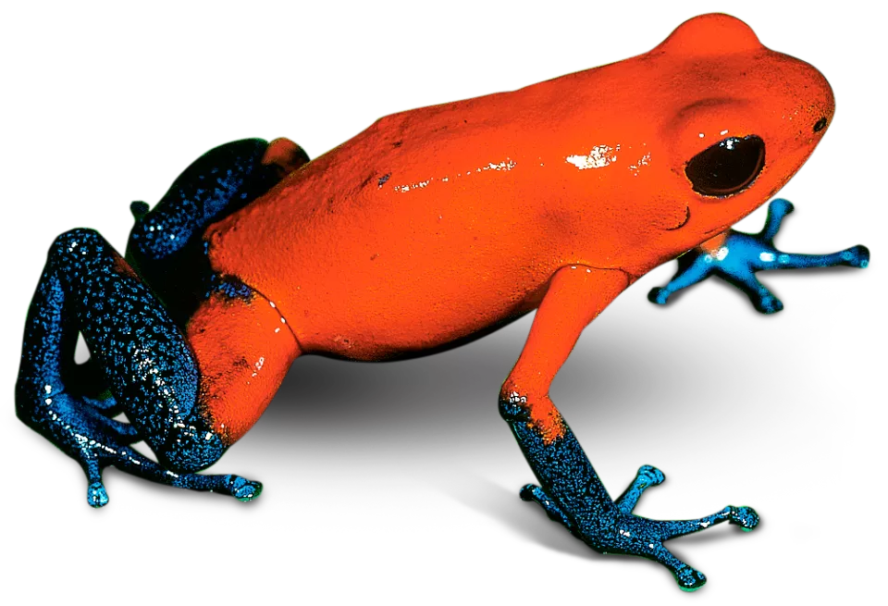
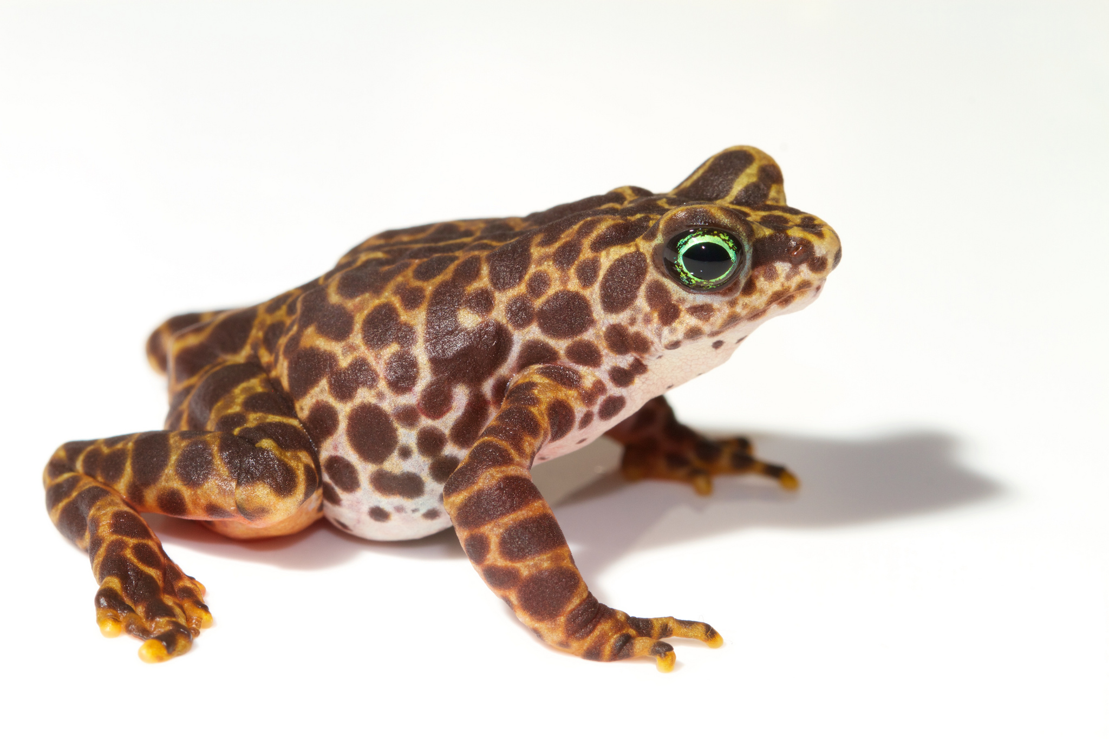
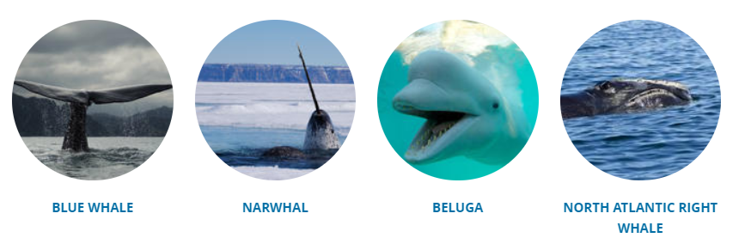
We will explain why we classify organisms.
Scientists use a scientific classification system to sort plants and animals into thousands of different groups. This helps them in the following ways:
To discover and name new organisms.
Identify animals as common or endangered.
Find animals that live in different places but look and live similar lives.
7 of the 13 types of whales are endangered.
Many have similar features, diets and habitats
CHECK FOR UNDERSTANDING
What is an observable feature of these 2 animals?

Slide 16
We will explain why we classify organisms.
Classification is a system of sorting organisms₁ such as plants and animals into different groups based on observable₂ features.
Classification helps identify newly discovered plants and animals that look similar to other animals.
Scientist speak different languages so they need a worldwide classification system to help classify similar animals.
CHECK FOR UNDERSTANDING
An italian scientists finds an animal she calls tigre She writes in research that is this animal is covered in fur with black and orange stripes What classification is this organism likely to belong to?
Observable features used to classify animals include:
Body cover: fur, scales, feathers, skin.
Amount of legs: 2, 4, 6, 8.
Body feature: shell, tentacles, claws, tail.

Slide 17
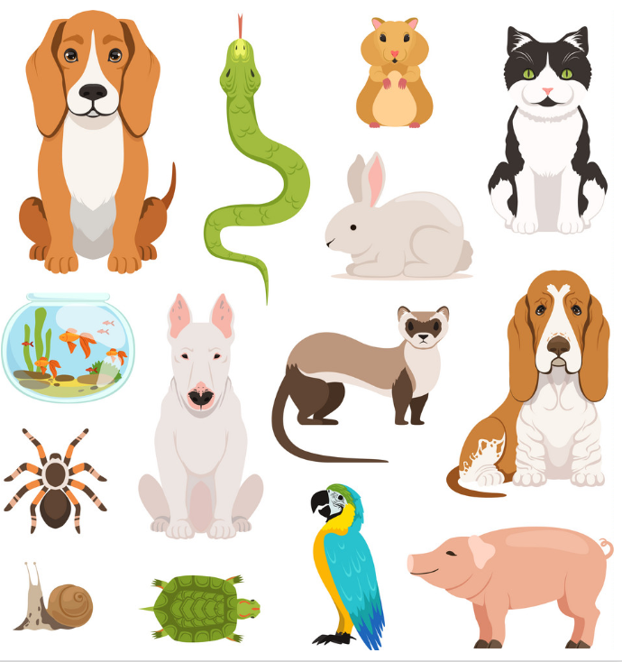
We will explain why we classify organisms.
Classify the following animals with your own observable features.
Compare your classification system with the person next to you. Describe how they are similar and different.
HINT
Students, remember…. Classification is a system of sorting organisms such as plants and animals into different groups based on observable features. Observable features used to classify animals include: Body cover: fur, scales, feathers, skin. Amount of legs: 2, 4, 6, 8. Body feature: shell, tentacles, claws, tail.
Notes:
https://www.vectorstock.com/royalty-free-vector/big-set-of-different-domestic-animals-cats-vector-16043579

Slide 18
We will explain why we classify organisms.
We will define classification.
We will explain why classification systems are helpful.
We will give observable features to classify animals.
CHECK FOR UNDERSTANDING
Check Success Criteria.

